Slide 1



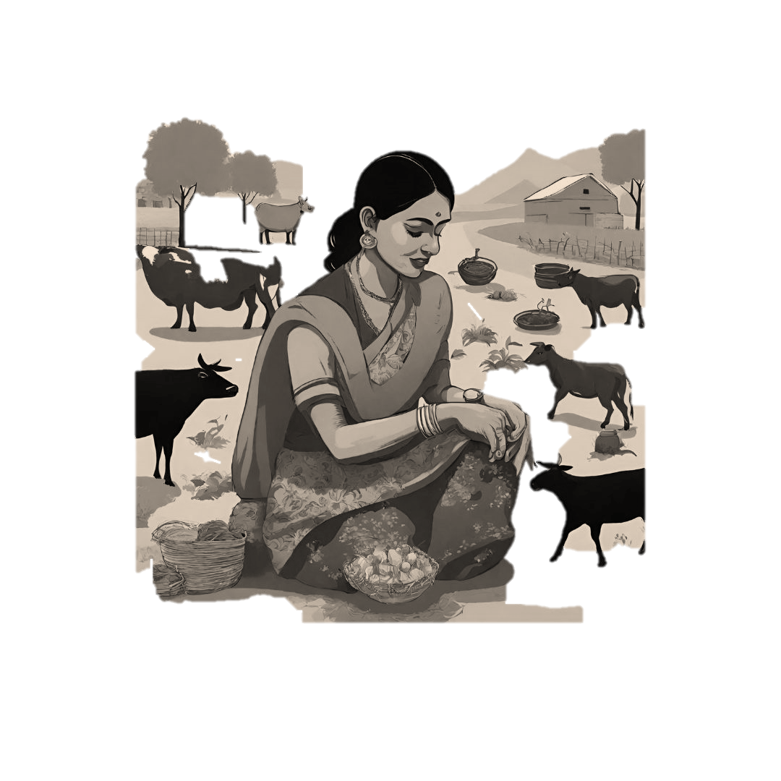



Session-8
Aajeevika Register
Notes:
This section will focus on understanding the concepts and elements of sustainable livelihoods.

Slide 2
Session overview:
Objective: | Orient participants in estimation of income from different activities and maintaining in the Aajeevika Register.
Outcomes: | Participants are aware about. Aajeevika Register format. Frequency of maintaining the register.
Topics: | Aajeevika Register overview. Purpose. Implementation strategy and steps. Livelihood activities and income estimation. Income Calculation Format & Steps. Consolidation and digitization of data.
Methodology: | Interactive Lectures Q&A Sessions
Resources: | Presentation, Aajeevika Register Templates

Slide 3
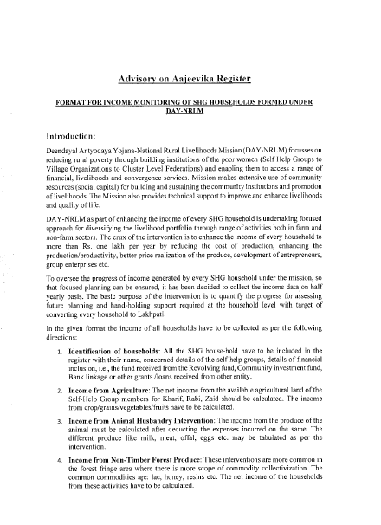
About the Aajeevika Register
Income Calculation
Process of data Collection
Template for HH Level Income Calculation
Template for Maintaining Register at VO Level
Advisory on Aajeevika Register- 20th Oct, 2023

Slide 4
Purpose of Aajeevika Register
Regular tracking of income of SHG household to monitor the enhancement in income of SHG members as per the planned activity in Lakhpati planning tool
Aajeevika Activities
Income
Aajeevika register
Implementation
Roles & Responsibilities

Slide 5
IMPLEMENTATION STEPS
Regular Data Updates and Monitoring
Regularly update the Digital Aajeevika Register with half-yearly income data.
Identification of households & CRPs and T&CB
Identification of households and financial details, T&CB of Staff and CRPs.
05
Enter Data into the Digital Aajeevika Register
Enter authenticated data into the Digital Aajeevika Register at the Village Organization (VO) level, with data entry carried out by livelihoods e-CRP.
01
04
Income data collection
Calculation of income from Agriculture, Animal Husbandry, Forest Produce, Enterprises, Government Schemes, Commissions, Remittances, Others.
Document, Authenticate, and Compile Data
To ensure accuracy, officials and bookkeepers verify data, which is then compiled at the village organization level
02
03
Aajeevika Activities
Income
Aajeevika register
Implementation
Roles & Responsibilities

Slide 6
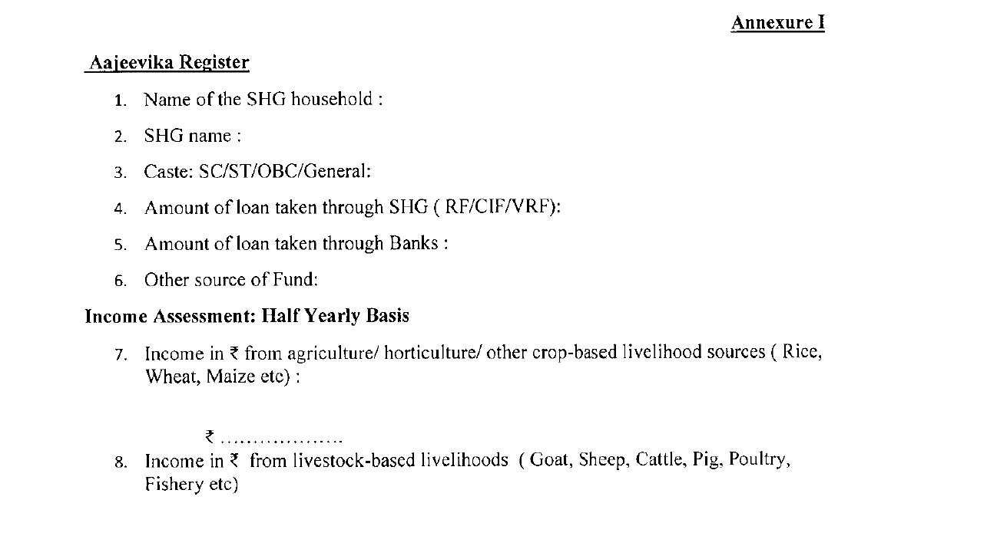
AAJEEVIKA REGISTER
It’s a comprehensive record, documenting the livelihood activities and income details of Self Help Group (SHG) households. It will be updated once in 6 months
Key Section: Basic details of HHs, Livelihood activities and income estimation.
Aajeevika Activities
Income
Aajeevika register
Implementation
Roles & Responsibilities
Notes:
The facilitator will link the previous responses with this slide and categorized the responses of the participants on the previous slide.

Slide 7


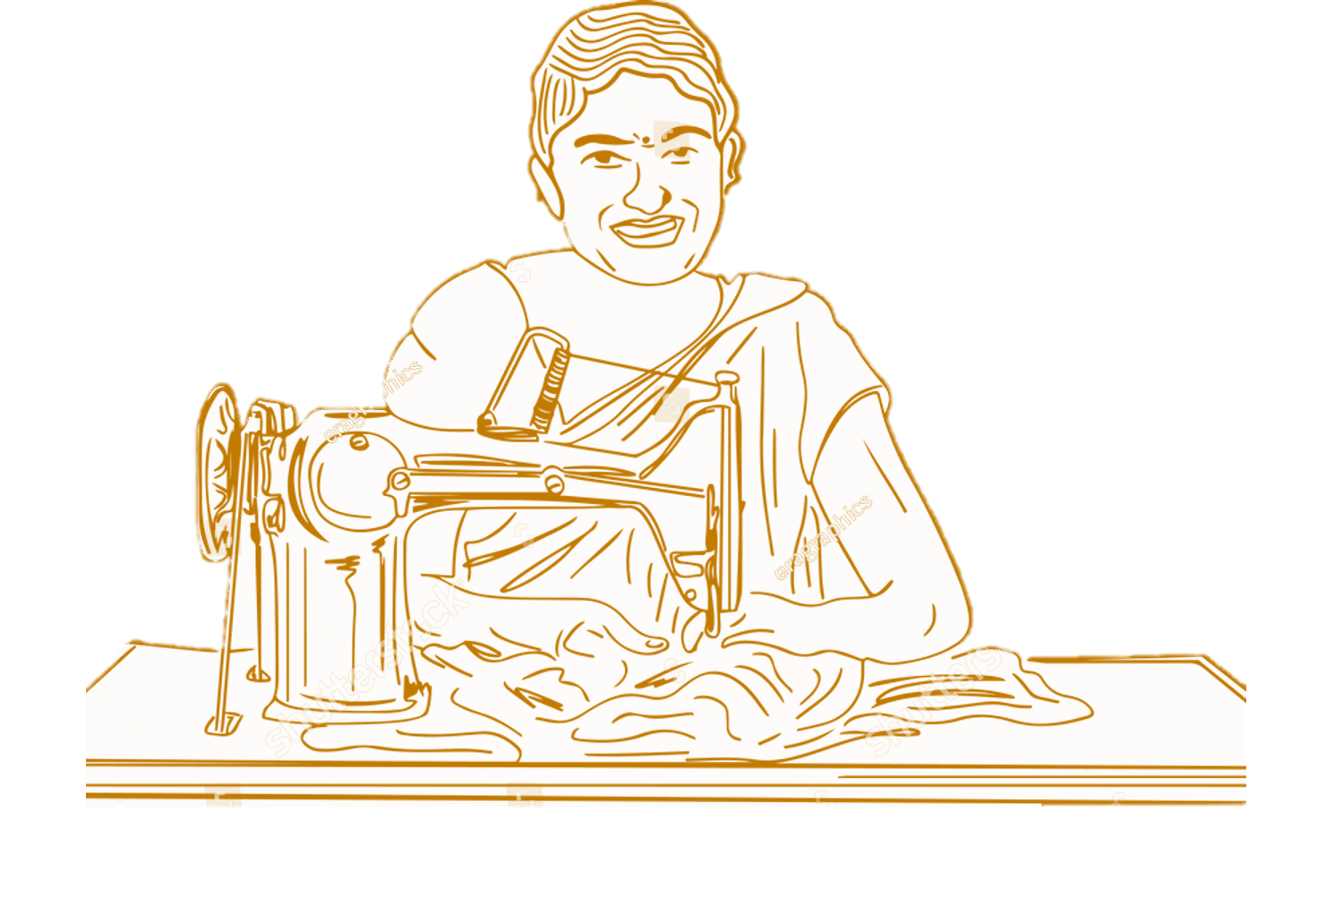
What are Aajeevika activities ?
Aajeevika activities are activities that households engage in to earn income and make a living.
Farm Based Non-farm Based (Manufacture, trade, Services)
Aajeevika Activities
Income
Aajeevika register
Implementation
Roles & Responsibilities
Group
Activity

Slide 8




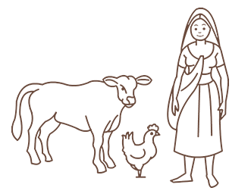
Farm Based Aajeevika activities:
Crop Based:
Crop Cultivation (Kharif, Rabi, Zaid crops)
Horticulture (Fruits, Vegetables)
Floriculture (Flower Farming)
Sericulture (Silk Farming)
Livestock & Dairy Based:
Dairy Farming (Milk Production)
Poultry Farming (Egg and Meat Production)
Fisheries and Aqua:
Fishery and Aquaculture
Forestry Based:
Forestry (Lac, Resin, Minor Forest produce etc.)
Beekeeping (Apiculture)
Aajeevika Activities
Income
Aajeevika register
Implementation
Roles & Responsibilities

Slide 9

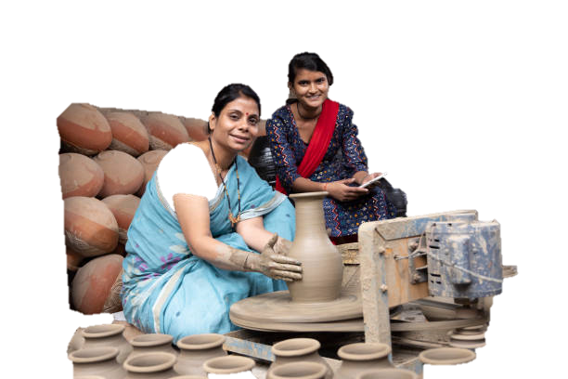


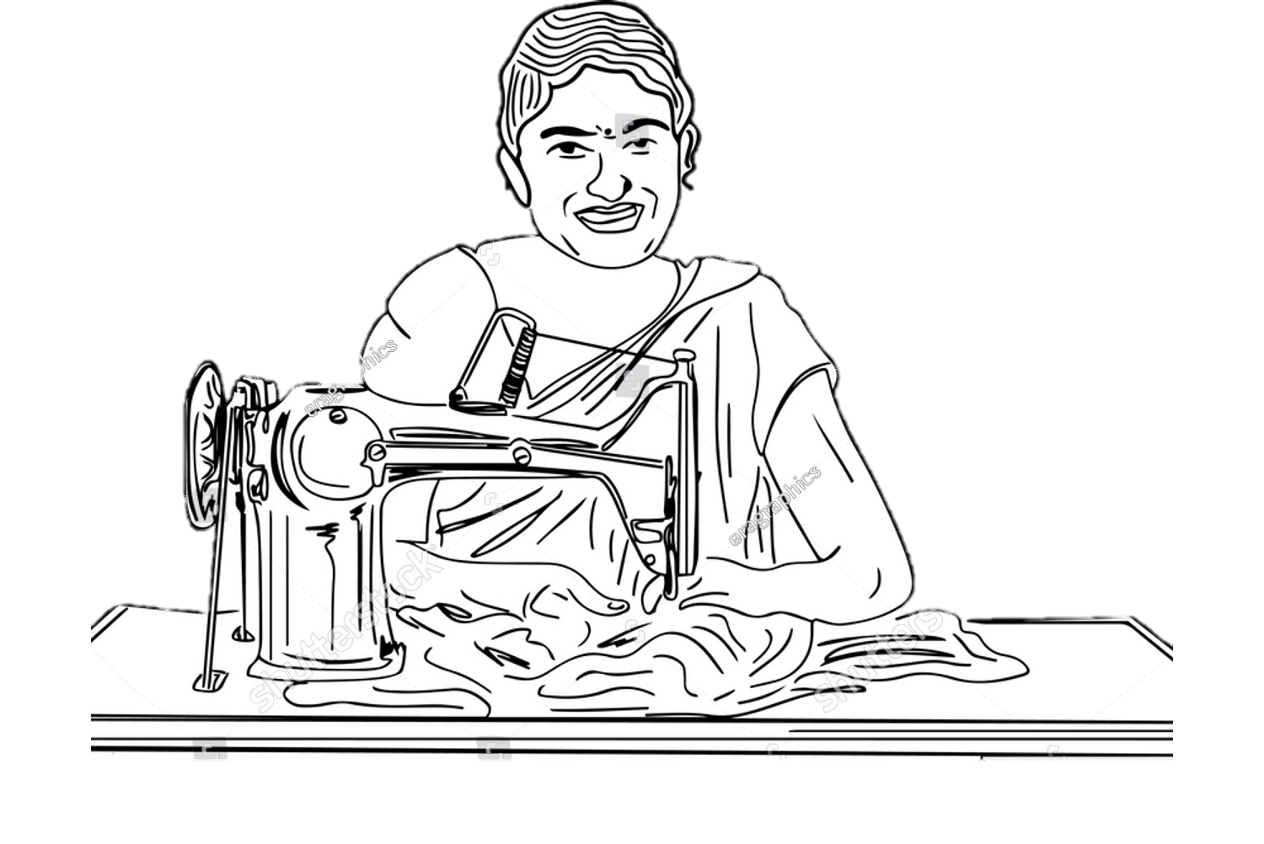

Non-Farm Based
Aajeevika activities
Handicrafts Production (Pottery, Weaving, Carpentry)
Handloom Weaving
Small-Scale Manufacturing (Cottage Industries)
Food Processing (Jam, Pickles, Bakery)
Artisanal Work (Jewelry Making, Embroidery)
Leather Goods Production (Shoes, Bags)
Candle Making
Soap and Detergent Production
Handicrafts Production (Carpets, Textiles)
Aajeevika Activities
Income
Aajeevika register
Queries and Observation
Queries and Observation
Notes:
The facilitator will link the previous responses with this slide and categorized the responses of the participants on the previous slide.

Slide 10



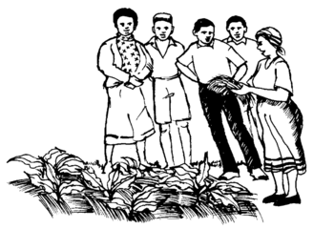
Service Based Aajeevika activities:
Cadre Service
Tourism and Hospitality Services
Transportation Services (Aajeevika Expres, CHC, Rickshaw etc.)
Repair and Maintenance Services (Mechanic, Electrician)
Financial Services (Microfinance, Banking Correspondents)
Information Technology (CSC)
Marketing and Sales Services (Agent, Sales Consultant).
Aajeevika Activities
Income
Aajeevika register
Implementation
Roles & Responsibilities
Notes:
The facilitator will link the previous responses with this slide and categorized the responses of the participants on the previous slide.

Slide 11

What is Income ?

Slide 12




What is Income ?
Amount of money, property, and other transfers of value received over a set period of time in exchange for services or products
Gross income: Earnings amount before taxes and other operating expenses.
Net income: Earning after deduction of all taxes and expenses.
Gross Income Expenses & Taxes Net Income
Aajeevika Activities
Income
Aajeevika register
Implementation
Roles & Responsibilities

Slide 13

Calculating Manufacturing, Trading, and Services Income
A. Calculation of Gross Income:
B. Deduction of Allowable Expenses
C. Calculation of Net Income:
Aajeevika Activities
Income
Aajeevika register
Implementation
Roles & Responsibilities

Slide 14
Calculating Agricultural Income for Individual Farmers
Identification of Agricultural Income Sources:
List down all main crops and subsidiary crops.
Record income from different Agri-source.
Crop Cultivation.
Livestock Farming.
Forestry.
Aqua Farming.
Rent from Agricultural Land.
Government Grants and Subsidies.
Calculation of Gross Agricultural Income:
Gross Agricultural Income Calculation. (Add up income from various agriculture sources)
Deduction of Allowable Expenses:
Cost of Cultivation (Expenses for seeds, fertilizers, etc.)
Livestock Expenses (Expenses for animal feed, vet care, etc.)
Maintenance Expenses (expenses for equipment, machinery, etc.)
Interest on Loans
Land Revenue and Rent
Insurance Premium
Calculation of Net Agricultural Income:
Subtract total allowable expenses from gross income
Aajeevika Activities
Income
Aajeevika register
Implementation
Roles & Responsibilities

Slide 15
STEPS OF DATA COLLECTION
Identification and selection of Lakhapti -CRPs (both in farm and non-farm sectors).
Training of Lakhpati -CRPs.
Conduct meetings with SHG members, gathering data with support from Lakhapti -CRPs.
Village organizations collect SHG data, submitting to cluster-level federation.
Cluster-level data entered into MIS portal by data entry personnel.
Introducing Format
Data Collection
Compilation
Digitization
Aajeevika Activities
Income
Aajeevika register
Implementation
Roles & Responsibilities

Slide 16
Member level entry format:
Sheet Link
VO level entry format:
Sheet Link
Practice Session: 15 Minutes

Slide 17
ROLES AND RESPONSIBILITIES
Level | Responsibilities
National | Provide training to State officials and State Resource Persons (SRPs) engaged in livelihoods. Ensure proper monitoring of the quality and quantity of data collected.
State | Train district/block livelihood officials. Oversee the training and implementation process. Assign Nodal person (SPM MIS) for effective monitoring at the state level.
District | Train and supervise block livelihood officials. Implement the process effectively within the district. Ensure proper monitoring of data quality and quantity in collaboration with the Committee.
Block | Train and assist livelihood e-CRPs. Implement the process effectively within the block. Ensure proper monitoring of data quality and quantity in collaboration with the CBO leaders and livelihood e-CRPs.
Aajeevika Activities
Income
Aajeevika register
Implementation
Roles & Responsibilities

Slide 18
ROLES AND RESPONSIBILITIES
Level | Responsibilities
CLF | Ensure data accuracy and completeness.
VO | Maintain and periodically update the Aajeevika Register. Compile information about SHGs and submit it to the cluster level federation.
Livelihood e-CRPs | Collect data at the member level from SHGs (Self Help Groups). Organize meetings with SHG members to explain data collection format. Authenticate information from members with the assistance of bookkeepers and officials. Receive honorarium as per CRP guidelines. Maintain the Aajeevika Register at the Village Organization (VO) level. Digitize collected data and ensure its authenticity.
D.L.C. (DM MIS and LH) | Ensure proper monitoring of the quality and quantity of data collected.
Aajeevika Activities
Income
Aajeevika register
Implementation
Roles & Responsibilities

Slide 19
Thank you

